Slide 1
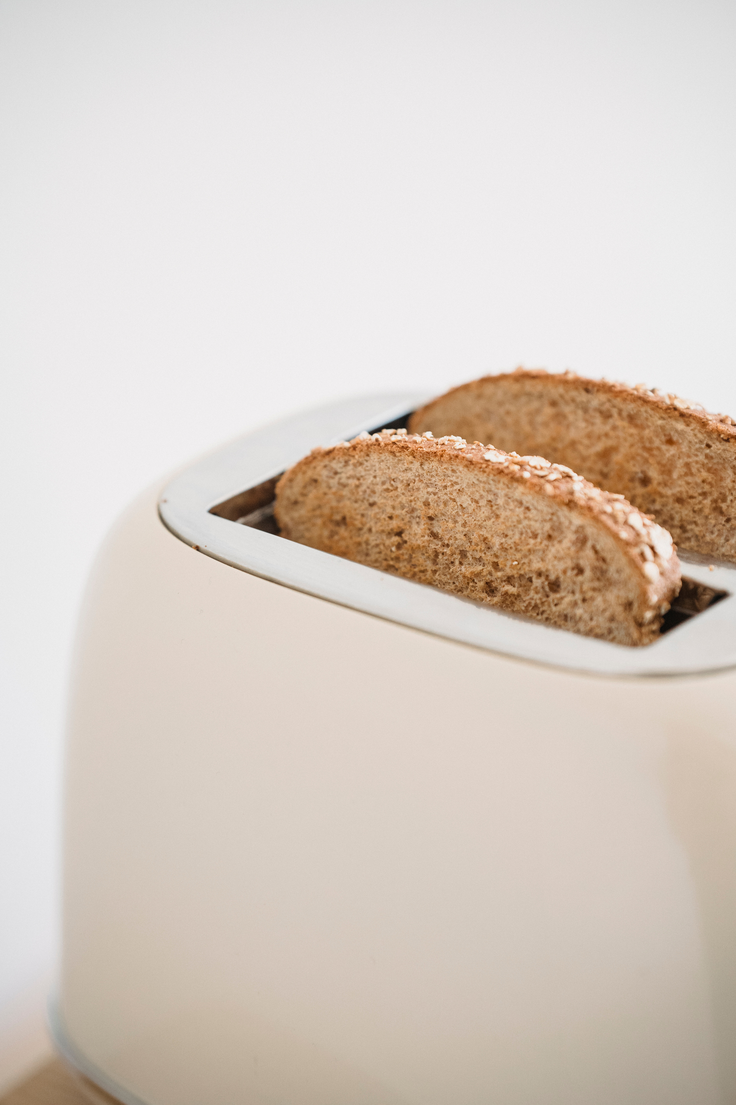

Delicious
Recipe Book

Slide 2

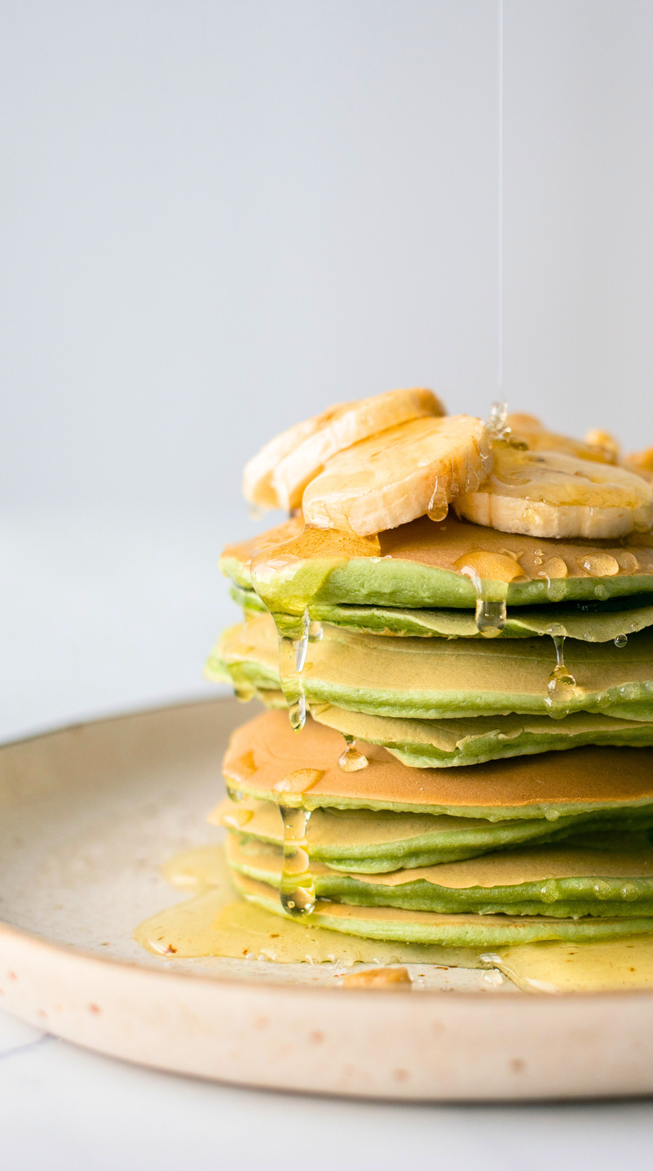
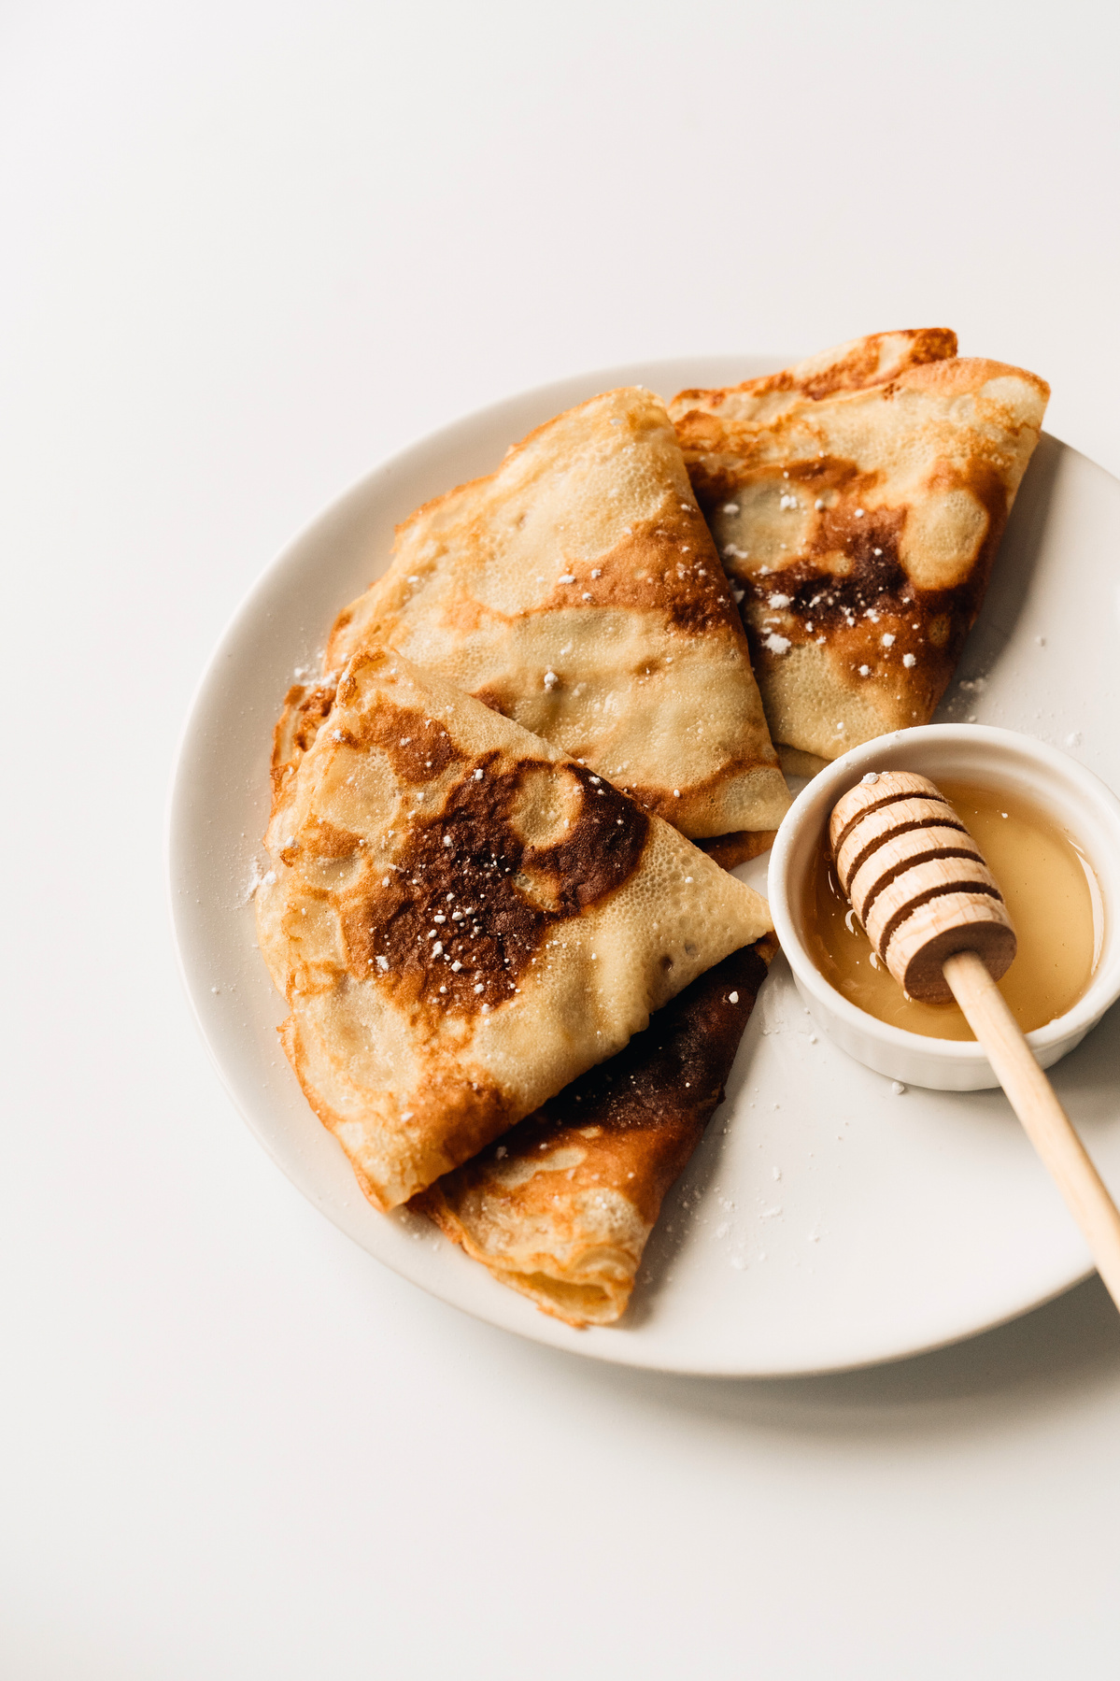
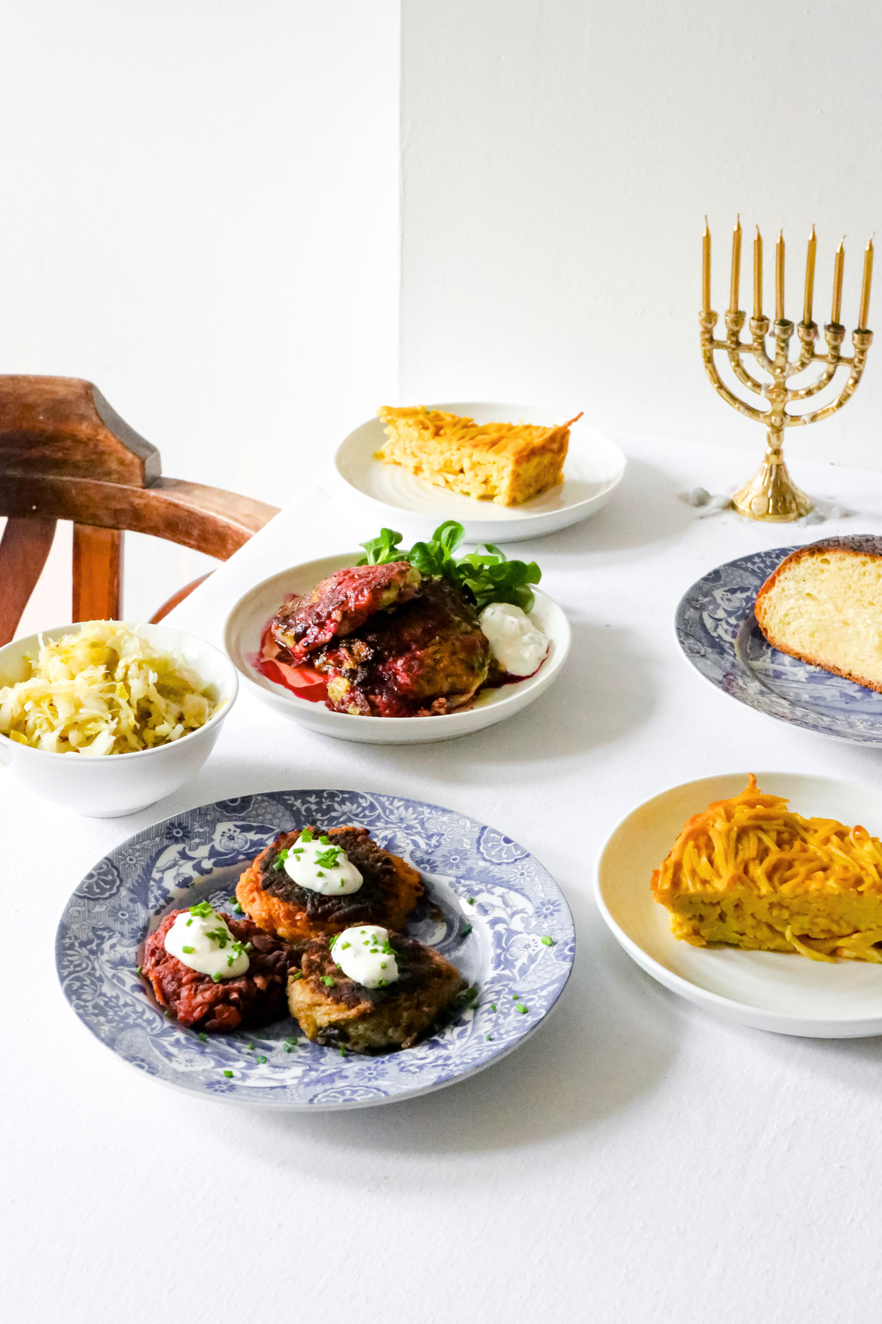

Introduction
Are you looking for some delicious recipes? Well, you've come to the right place! Our recipe book website is filled with mouthwatering recipes that will surely satisfy your cravings. Whether you're in the mood for a savory dish or a sweet treat, we've got you covered. Get ready to embark on a culinary adventure! 🍽️

Slide 3
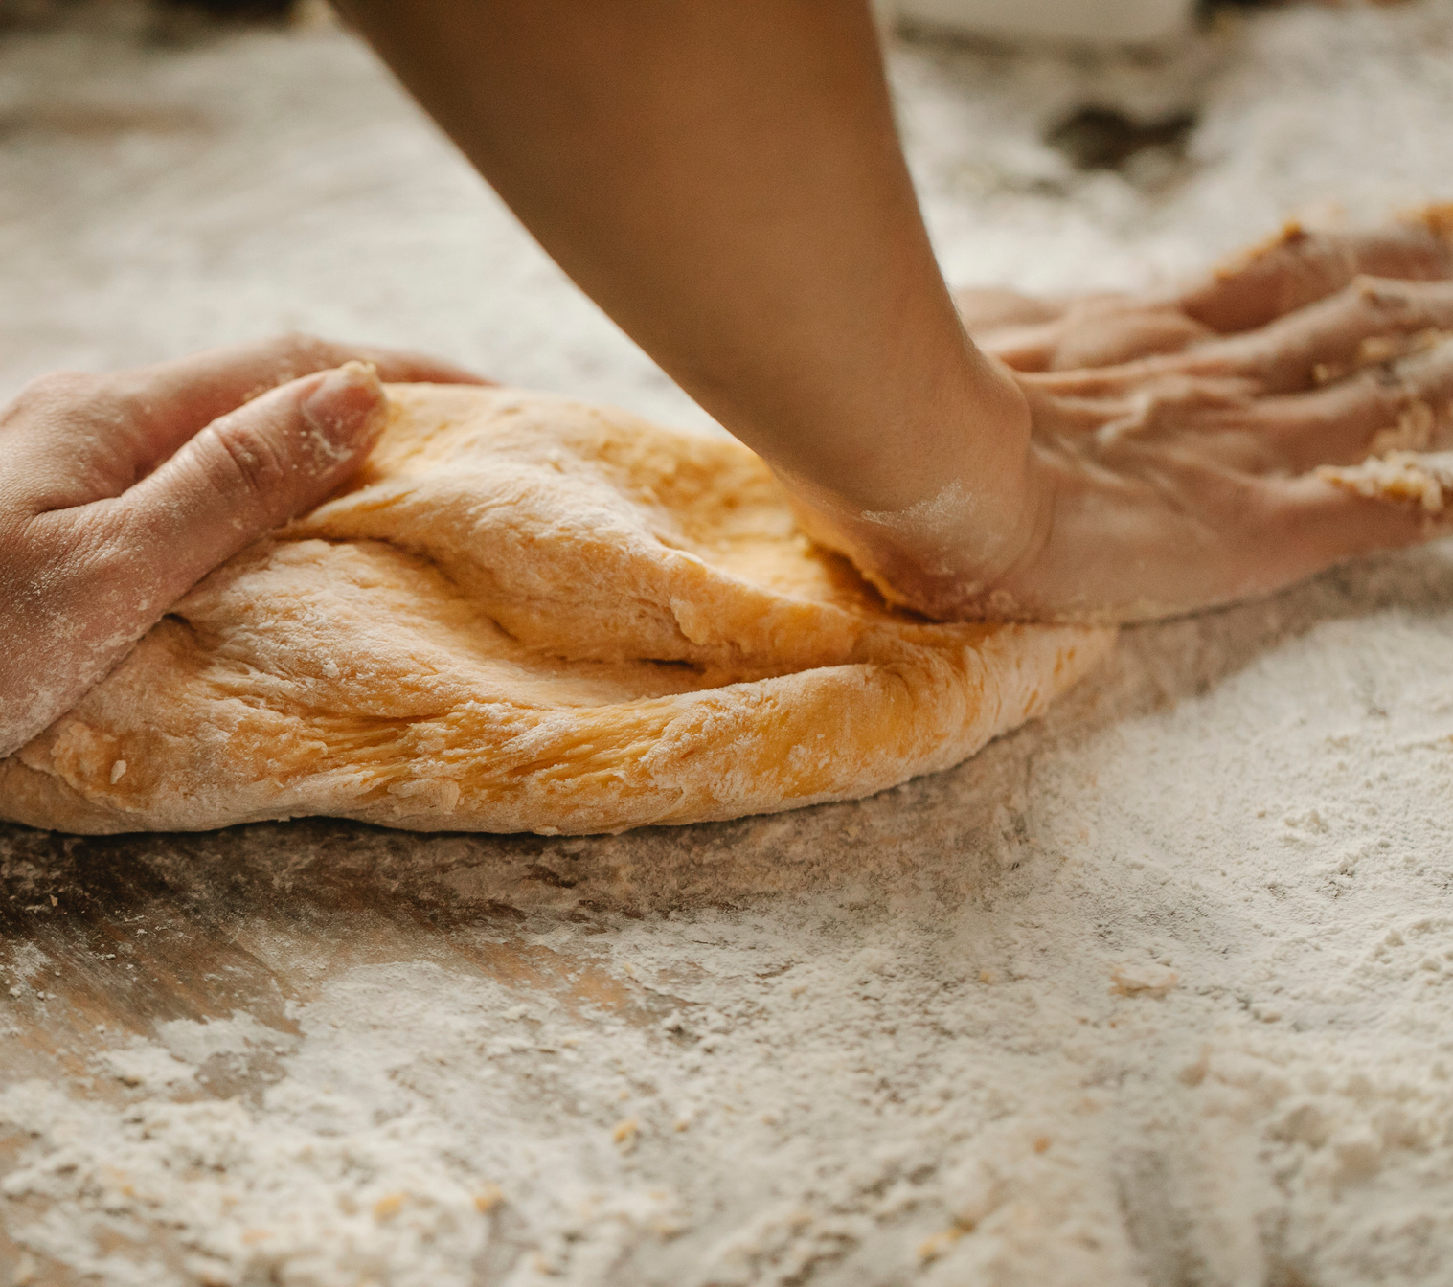
Get ready to cook up a storm!
Explore our recipe website for tasty inspiration!

Slide 4
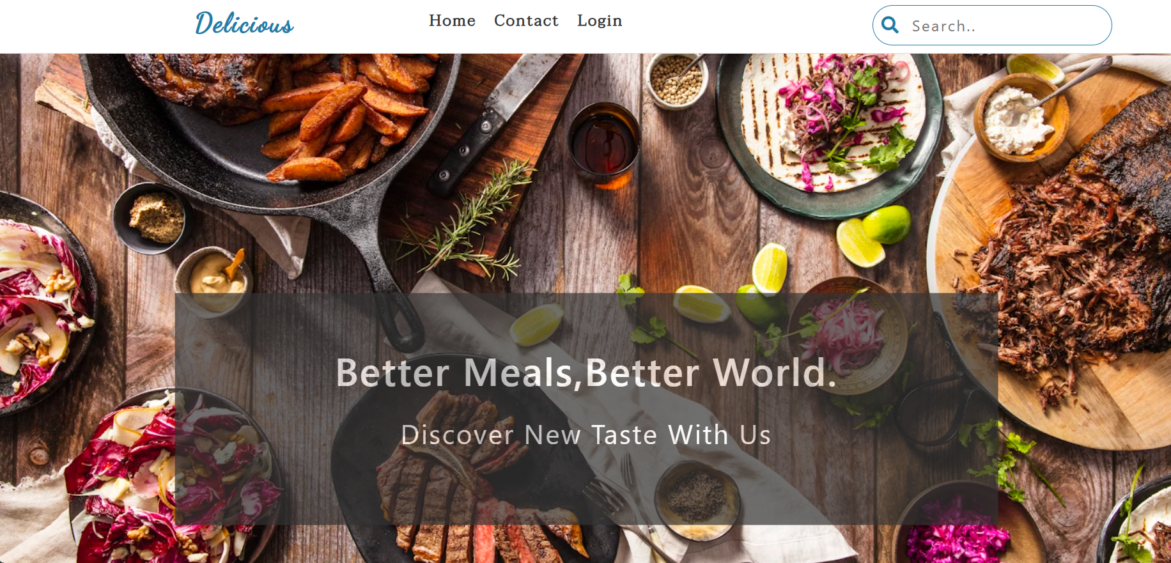

Slide 5
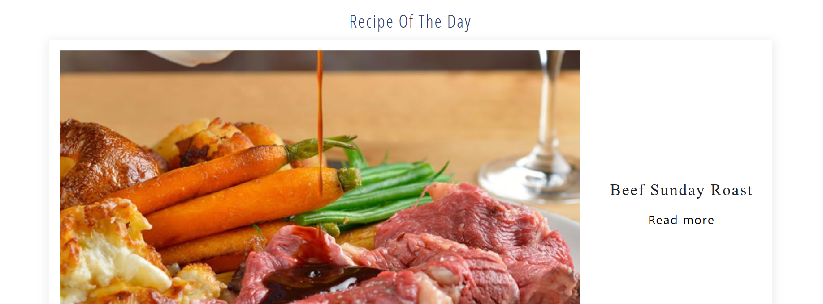
Become a Professional Chef
Taste something new
every day.

Slide 6


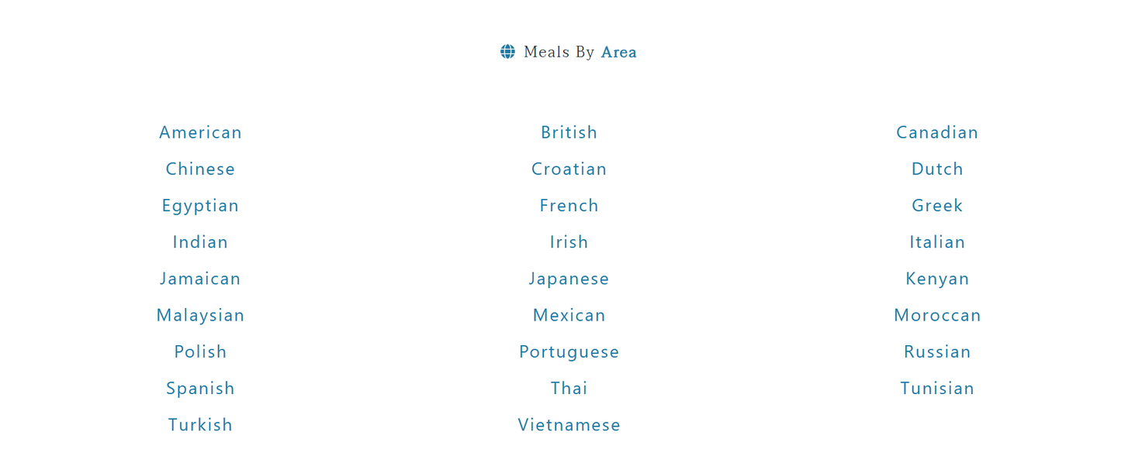
Look Up a Recipe by Region

Slide 7


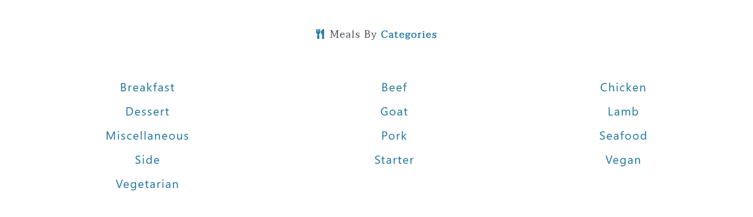

Look Up a Recipe by Catagory

Slide 8
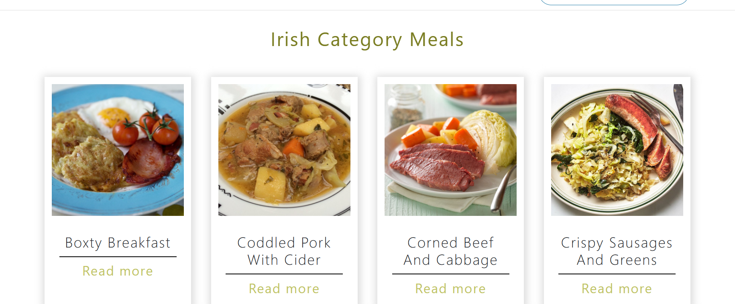
Let’s Get Cooking

Slide 9
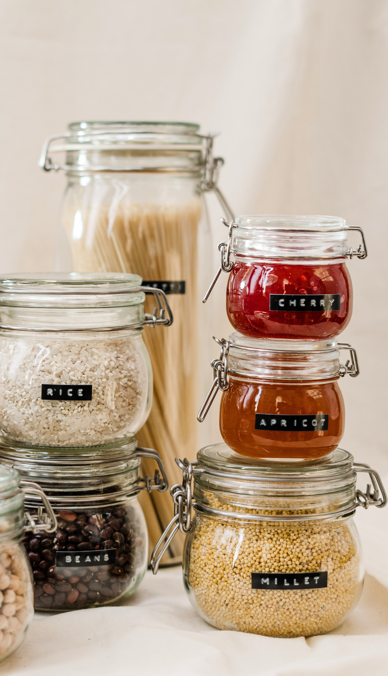
Tech Stack
01
HTML
02
04
CSS
BOOTSTRAP
03
05
JAVASCRIPT
RAPID API

Slide 10





TEAM MEMBERS
BHUMI GARG
2210990226
BHAVIKA GOYAL
2210990219
DRISHYA SOOD
2210990307
HIMANSHU KHOLI
2210990404

Slide 11

Thank You!

